Slide 1
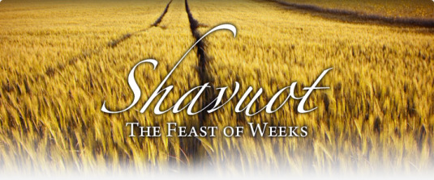

Slide 2
What to know about feasts/festivals in general:
Lev 23:1 – ‘YHWH said to Moses, 2“Speak to the Israelites and say to them: ‘These are my appointed festivals, the appointed festivals of the Lord, which you are to proclaim as sacred assemblies.’
Neh 8: 13-18
17The whole company that had returned from exile built temporary shelters and lived in them. From the days of Joshua son of Nun until that day, the Israelites had not celebrated it like this. And their joy was very great.
They are His feasts
They were celebrated throughout the OT by the patriarchs. YHWH always intended to make these occasions memorable by emphasizing the fun and festive element of His feasts.
They were celebrated by Jesus/Yahusha and his
disciples in the NT
At some point after Jesus and his disciples kept these feasts, Christians stopped keeping them. Unfortunately Rome made Christianity somewhat different to what we see in Acts so we are bit by bit finding these lost truths again….
Acts 18: 21
20When they desired him [Paul] to tarry longer time with them, he consented not; 21But bade them farewell, saying, I must by all means keep this feast that cometh in Jerusalem: but I will return again unto you, if God will. And he sailed from Ephesus.
Also see Acts 20: 16 and 1 Cor 16: 8

Slide 3
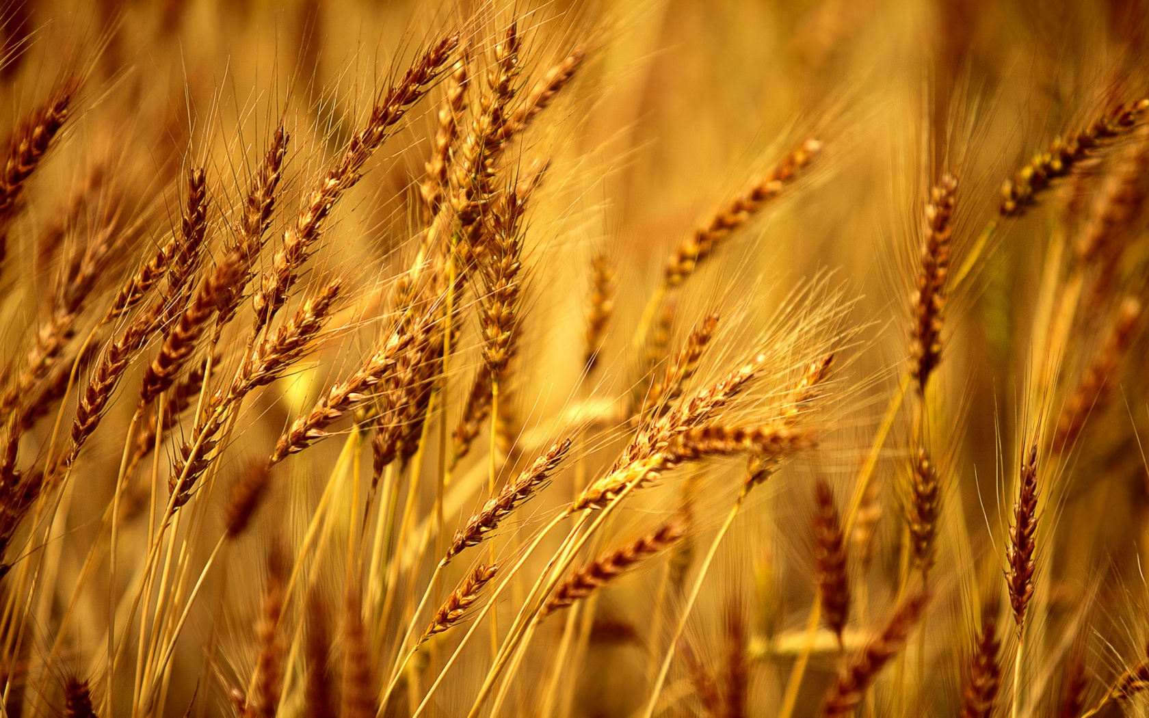
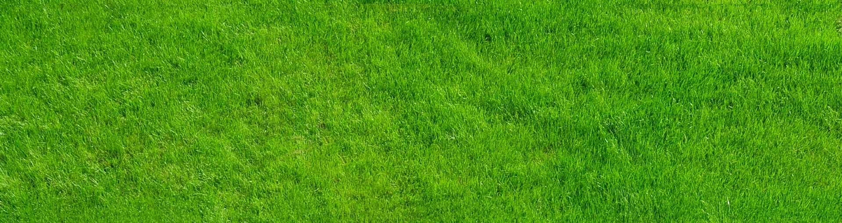
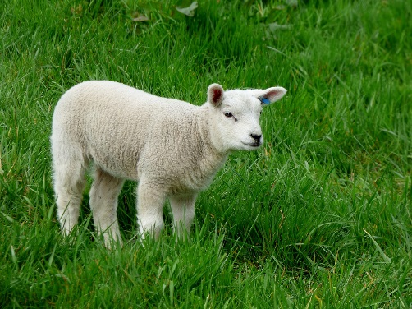
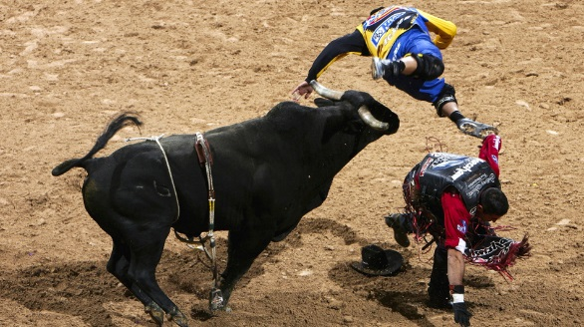
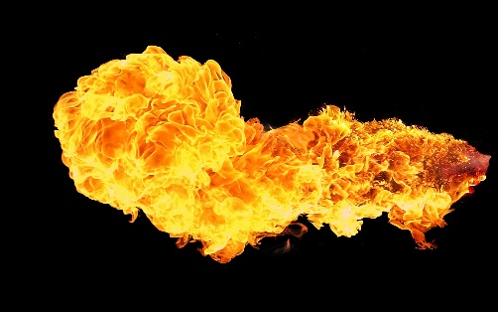
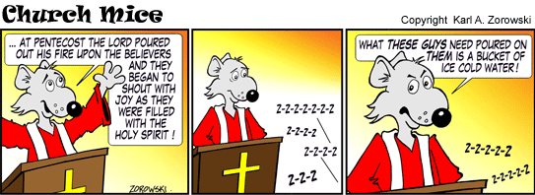
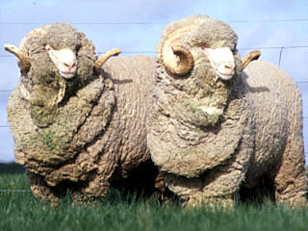
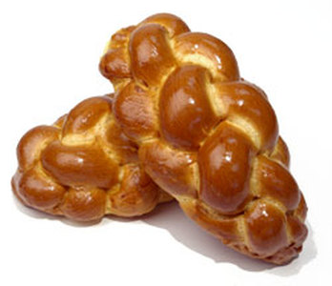
OT
NT
Lev 23:17
From wherever you live, bring two loaves made of two-tenths of an ephah of the finest flour, baked with yeast, as a wave offering of firstfruits to the Lord. 18Present with this bread seven male lambs, each a year old and without defect, one young bull and two rams. They will be a burnt offering to the Lord, together with their grain offerings and drink offerings—a food offering, an aroma pleasing to theLord. 19Then sacrifice one male goat for a sin offeringand two lambs, each a year old, for a fellowship offering. 20The priest is to wave the two lambs before the Lordas a wave offering, together with the bread of the firstfruits. They are a sacred offering to the Lordfor the priest. 21On that same day you are to proclaim a sacred assembly and do no regular work. This is to be a lasting ordinance for the generations to come, wherever you live.
Acts 2:1 - 4
When the day of Pentecost came, they were all together in one place. 2Suddenly a sound like the blowing of a violent wind came from heaven and filled the whole house where they were sitting. 3They saw what seemed to be tongues of fire that separated and came to rest on each of them. 4All of them were filled with the Holy Spirit and began to speak in other tongues as the Spirit enabled them.

Slide 4
The cycle of 7 feasts…
Passover
Unleavened
Bread & 1st Fruits
The Creators picture to mankind of Salvation and Redemption
We are focusing on Pentecost here so the others just just mentioned but not gone into detail at all, so ask us if you want more info.
Pentecost
Day of
Atonement
Trumpets
Tabernacles

Slide 5
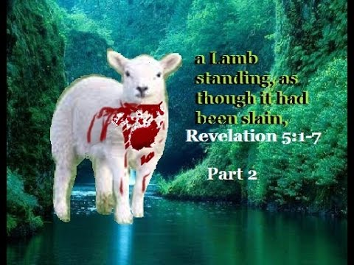
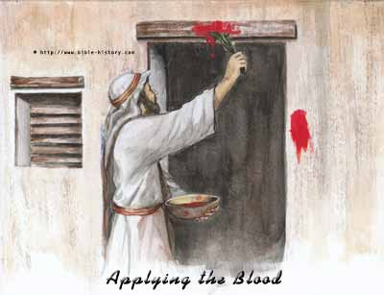
The 7 feasts…
Passover
Rev 5: 6-9
Unleavened
Bread & 1st Fruits
The shedding of blood for the forgiveness of sins – we celebrate and remember what was done in Egypt, and more NB through the Messiah
Exo 12: 3-30
Pentecost
Day of
Atonement
Trumpets
Tabernacles

Slide 6
The 7 feasts…
Passover
Unleavened
Bread & 1st Fruits
Pictures our commitment to come out of a sinful life, and live our lives by Elohims (Gods) perfect law. The Messiah was the 1st fruits, when after his resurrection He returned to the Father
Pentecost
Day of
Atonement
Trumpets
Tabernacles

Slide 7
The 7 feasts…
Passover
Lev 23: 9 – 14
Acts 2: 1 - 13
Unleavened
Bread & 1st Fruits
By this point we realize that we cannot die to our old self and rid ourselves of sin without the help of the Holy Spirit – Holy Spirit poured out here to help us keep His law.
His Spirit empowers us with the love of God, the motivation to obey Him and a sound mind to discern His truth. Us believers have a pledge or down payment on eternal life and can look forward to the first resurrection, which is to eternal life in Gods family.
Here we are given the mission of preaching the good news of the Kingdom of God in preparation for the next step in Gods plan, the return of Yahusha. This is pictured by the next festival, the Feast of Trumpets.
Pentecost
Trumpets
Tabernacles
Day of
Atonement

Slide 8
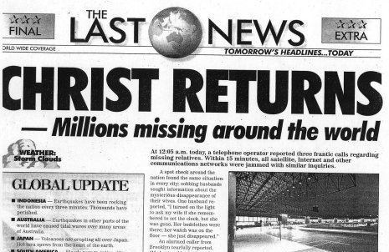
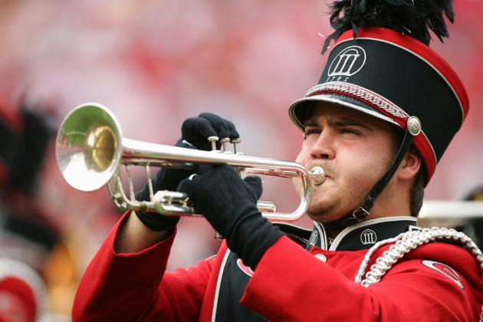
The 7 feasts…
Passover
Unleavened
Bread & 1st Fruits
1 Cor 15: 52…
50I declare to you, brothers and sisters, that flesh and blood cannot inherit the kingdom of God, nor does the perishable inherit the imperishable. 51Listen, I tell you a mystery: We will not all sleep, but we will all be changed—52 in a flash, in the twinkling of an eye, at the last trumpet. For the trumpet will sound, the dead will be raised imperishable, and we will be changed. 53For the perishable must clothe itself with the imperishable, and the mortal with immortality. 54When the perishable has been clothed with the imperishable, and the mortal with immortality, then the saying that is written will come true: “Death has been swallowed up in victory.” 55“Where, O death, is your victory? Where, O death, is your sting?” 56The sting of death is sin, and the power of sin is the law. 57 But thanks be to God! He gives us the victory through our Lord Jesus Christ.
Us celebrating and eagerly awaiting the return of the Messiah
Pentecost
Day of
Atonement
Trumpets
Tabernacles

Slide 9
The 7 feasts…
Passover
Unleavened
Bread & 1st Fruits
End time JUDGEMENT
Rev 11:18-19 The time has come for judging the dead, and for rewarding your servants the prophets and your people who revere your name,
both great and small— and for destroying those who destroy the earth.”
Then God’s temple in heaven was opened, and within his temple was seen the ark of his covenant. And there came flashes of lightning, rumblings, peals of thunder, an earthquake and a severe hailstorm.
Pentecost
Trumpets
Day of
Atonement
Tabernacles

Slide 10
The 7 feasts…
Passover
Fulfilled in New Jerusalem when YHWH dwells with us forever!
Rev 21: 1Then I saw “a new heaven and a new earth,” for the first heaven and the first earth had passed away, and there was no longer any sea. 2I saw the Holy City, the new Jerusalem, coming down out of heaven from God, prepared as a bride beautifully dressed for her husband. 3And I heard a loud voice from the throne saying, “Look! God’s dwelling place is now among the people, and he will tabernacle with them. They will be his people, and God himself will be with them and be their God.”
Unleavened
Bread & 1st Fruits
Pentecost
Day of
Atonement
Tabernacles
Trumpets

Slide 11
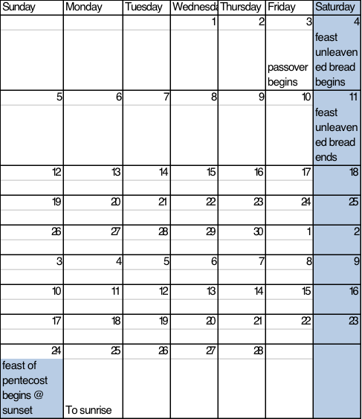
Spring Feast timeline ( 2015 )
Messiah’s blood atones for our sins
Then we need to looking introspectively, and
repent of sin in our lives and live according
to Gods perfect laws
We cant do this on our own – hence his
willingness to pour out His Spirit to help
us

Slide 12
Spring Feast timeline
Messiah’s blood atones for our sins
Then we need to look introspectively, and
repent of sin in our lives and live according
to Gods perfect laws
We cant do this on our own – hence his
willingness to pour out His Spirit to help
us

Slide 13

Spring Feast timeline
Messiah’s blood atones for our sins
Then we need to looking introspectively, and
repent of sin in our lives and live according
to Gods perfect laws
We cant do this on our own – hence his
willingness to pour out His Spirit to help
us

Slide 14
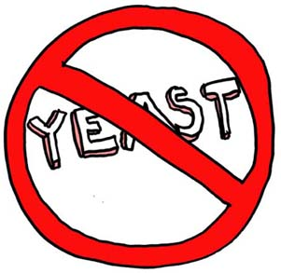
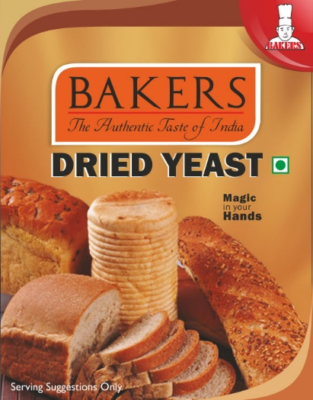
So lets break it down….
In the old testament they celebrated the Feast of Pentecost with Animal offerings/sacrifices that were given
but the distinct difference was that loaves of bread containing yeast were offered. This is the only time
throughout the bible that yeast was allowed in an offering.
So what is the significance of yeast/leaven?
or
Mt 16:12 Then they understood how that he told them not to beware of the leaven (yeast ) of bread, but of the doctrine of the Pharisees and of the Sadducees.
Lk 12:1 Meanwhile, when a crowd of many thousands had gathered, so that they were trampling on one another, Jesus began to speak first to his disciples, saying: “Be on your guard against the yeast of the Pharisees, which is hypocrisy.
1C 5:6-8 Your boasting is not good. Don’t you know that a little yeast leavens the whole batch of dough? 7Get rid of the old yeast, so that you may be a new unleavened batch—as you really are. For Christ, our Passover lamb, has been sacrificed. 8 Therefore let us keep the Festival, not with the old bread leavened with malice and wickedness, but with the unleavened bread of sincerity and truth.
Scripture interprets scripture so we see from the above that leaven/yeast
is seen to represent sin, hypocrisy, false doctrine etc.

Slide 15
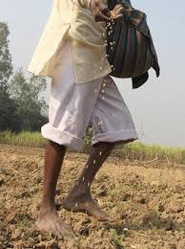
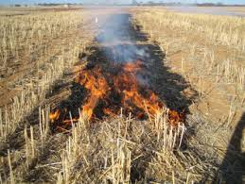
Pentecost is a celebration of the wheat harvest
Ex 34:22 22“Celebrate the Festival of Weeks with the firstfruits of the wheat harvest…
Mt 13:24 . Jesus told them another parable: “The kingdom of heaven is like a man who sowed good seed in his field. 25But while everyone was sleeping, his enemy came and sowed weeds among the wheat, and went away. 26When the wheat sprouted and formed heads, then the weeds also appeared.
Mt 13:37 He answered and said unto them, He that sows the good seed is the Son of man;
Mt 13:38 The field is the world; the good seed are the children of the kingdom; but the weeds are the children of the wicked [one];
John the Baptist said:
Mt 3: 11“I baptize you with water for repentance. But after me comes one
who is more powerful than I, whose sandals I am not worthy to carry. He will
baptize you with the Holy Spirit and fire. 12His winnowing fork is in his hand,
and he will clear his threshing floor, gathering his wheat into the barn and
burning up the chaff with unquenchable fire.”

Slide 16
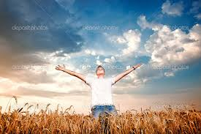
So those scriptures in Matthew set the scene of the interperatation of the
field = the world
good seed of wheat = children of YHWH
weeds/tares = children of the evil one
Then Matthew 3 ties it together with John the Baptist tying up the illustration of
us being the wheat to the future event of baptism of the Holy Spirit and fire.

Slide 17
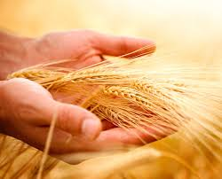
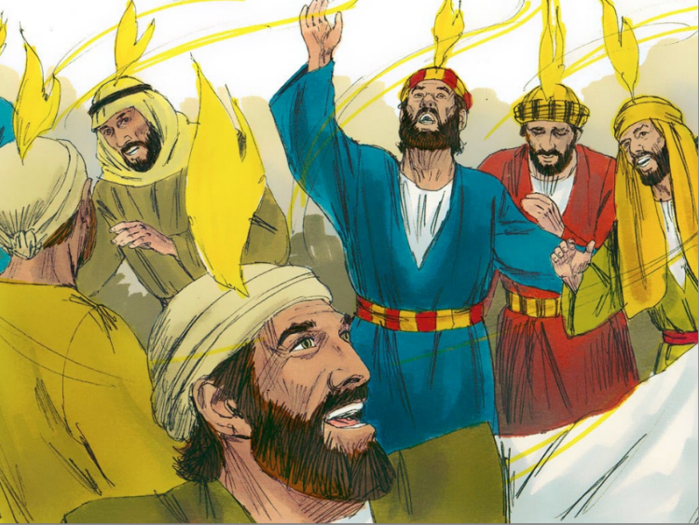
Holy Spirit comes on the Feast of Pentecost
Acts 2:1 When the day of Pentecost came, they were all together in one place. 2 Suddenly a sound like the blowing of a violent wind came from heaven and filled the whole house where they were sitting. 3 They saw what seemed to be tongues of fire that separated and came to rest on each of them. 4 All of them were filled with the Holy Spirit and began to speak in other tongues as the Spirit enabled them.
Amazing!

Slide 18
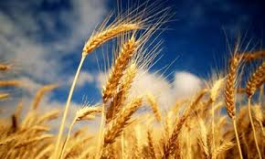
John 12:23 Jesus replied, “The hour has come for the Son of Man to be glorified.24 Very truly I tell you, unless a kernel of wheat falls to the ground and dies, it remains only a single seed. But if it dies, it produces many seeds. 25Anyone who loves their life will lose it, while anyone who hates their life in this world will keep it for eternal life.
Dying to self
Matt 16:24
Romans 6:1-14

Slide 19
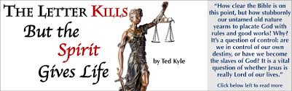
Jews believe that the Torah was given to Moses on Mt Sinai near the time of the Feast of Pentecost. Sadly that day Moses came down and saw the people worshipping the Golden Calf and so 3000 people were killed that day….(Exodus 32:25-27 )
Incredibly on the Feast of Pentecost as Peter spoke to all the people about the Good News it says this:
Acts 2:41 Those who accepted his message were baptized, and about three thousand were added to their number that day.
2 Cor 3:4-18

Slide 20
Big Picture
Feast of Pentecost is an amazing picture of how after accepting the Messiah as our Passover Lamb who atones for our sins….then spending a week in Feast of Unleavened Bread looking deeply into ourselves and becoming aware and repenting of our sin…. then 50 days later we realise that we are still sinful human beings! But in this feast we see how our Father accepts us as we are, sinful beings with false doctrine, hypocritical actions etc ( represented by the loaves with yeast in them waved before him). We see then that its only by the Holy Spirit’s power that we can overcome the sin in our lives and live according to His Torah, and that is why it is on this Feast that he poured His Spirit out on the first disciples!

Slide 21
Lessons in feast of Pentecost
We are the wheat….. wheat must fall to ground and die ie we must die to self, before it will bring forth fruit…. Completely not be taken in by things of this world, lay down all our hopes and dreams to Him…
At end of time the wheat is gathered into the barn and the chaff is burnt up
The field is the kingdom and there is wheat and weeds there….will grow together until the harvest when the tares are first removed and thrown into the fire and burnt, and we are then harvested….therefore there will be true and false believers present in the body of believers until the end
Saviour was going to baptize with fire, and at feast of Pentecost the disciples were all together when mighty wind came and tongues of fire rested on each of them and they spoke in tongues….different to being thrown in the fire… again, fire can destroy or it can ( like silver and gold ) refine and purify.
The loaves of bread in OT offered are uniquely with yeast/leaven…. Signifying sin/hypocricy/false doctrine etc….yet again there is the theme of sin existing within the body and how this time the Father accepts that offering….as in, he acknowledges that we still sin but he accepts us as we are. Following the feast cycle we would have accepted the Messiah as our Passover lamb which restores us into covenant with the Father.... We go through the time of introspection in feast of unleavened bread and are made aware of the sin and false doctrine in our lives... And then we come humbly to feast of Pentecost where we present ourselves as a loaf made of wheat and yeast...admitting we need his Holy Spirit to enable us to overcome sin. And in His mercy YHWH accepts us. Incredible.
He warns us that unless we die to self, we will not produce fruit…Lets produce fruit for him in this year to come!

Slide 22


