Slide 1
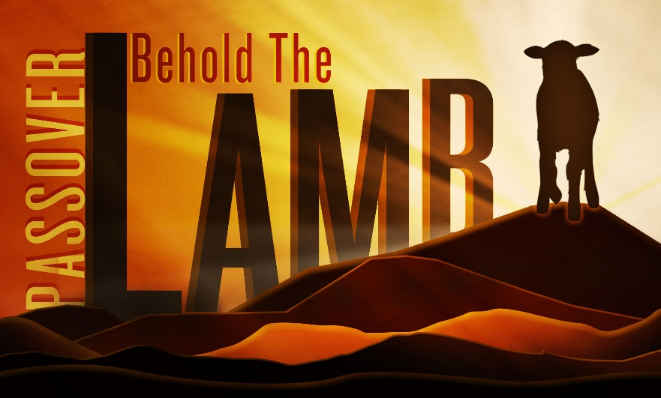
Passover 2019
Welcome!

Slide 2
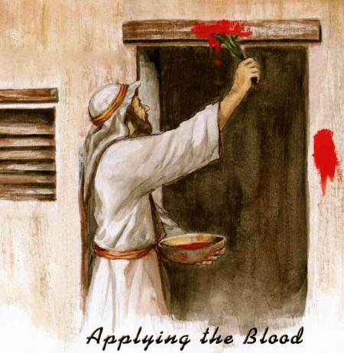
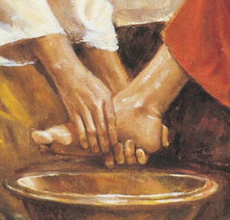
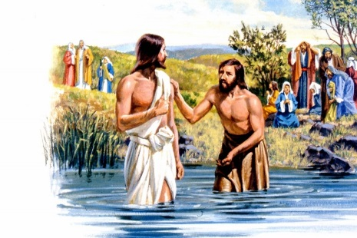

Four main points
1. Passover - physical
2. Levitical → Melchezidek
3. Passover - Spiritual
4. How did the Messiah keep the Passover?
Notes:
We remember the original Passover that was declared when the Israelites were still in Egypt and were being called out to escape to the Promised Land. They had to slaughter a lamb and put the blood on the doorposts of their houses so that the destroying angel would pass over their house, instead of killing their firstborn.
We will look at how the priesthood is transferred from the Levitical to the Melchizedek as we see through examples of John the Baptist (legitimate high priest – descendant of Aaron on both sides) and Caiaphas who was the illegitimate high priest who occupied high priest position in Yahusha’s day. We remember that Yahusha went to John in Mathew 3:13 to be baptised by John. Then YHWH declared this is my son whom I love with whom I am well pleased, which illustrates blessing and approval of his position, as well as Caiaphas who disobeyed Torah by tearing his robes – out with the old, in with the new.
https://www.bible.com/en-GB/bible/116/MAT.3.nlt
https://www.bible.com/en-GB/bible/116/LEV.21.nlt
We recognize now that the Torah is spiritual and that Passover is kept in a spiritual way
Rom 7: 14: https://www.bible.com/en-GB/bible/116/ROM.7.nlt
1 Cor 5: 6 to 8: https://www.bible.com/en-GB/bible/116/1CO.5.nlt
Whenever we consider doing something in the bible, we should always consider how Messiah did it as an example to the rest of us as to how we should be doing it.

Slide 3
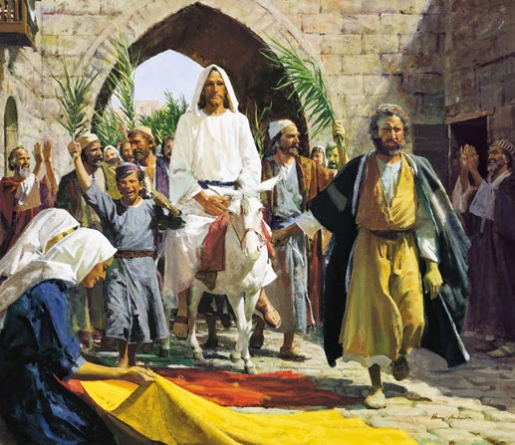
1. Passover - physical
Read John 20: 1
'Early on the first day of the week, while it was still dark, Mary Magdalene went to the tomb and saw that the stone had been removed from the entrance. '
John 20:1
https://www.bible.com/bible/111/JHN.20.1
Read Mark 16: 2
‘And very early in the morning the first day of the week, they came unto the tomb at the rising of the sun.’
Mark 16:2
https://www.bible.com/bible/111/MRK.16.2
 | Day of the month | 1st Passover | Messiah’s Passover
13th | Passover lamb selected | Exo 12: 3 Male lamb without defect. | Mat 21: 1 – 11; John 12: 1 – 13 Messiah comes to Jerusalem to people singing “Hosanna”
14th | Passover lamb slaughtered between evenings on the 14th | Exo 12: 6 – 11 Passover lamb slaughtered between the evenings, blood painted on the doorposts, lamb roasted and eaten. | Mark 15: 25; John 19:14; John 18: 28 Messiah ate Passover with his disciples. Messiah impaled on the same day (“Hebrew day”), Wednesday that year.
15th | 1st day of Unleavened Bread | Lev 23: 5 – 6 Starting day of Unleavened bread day feast. Also day Israelites escaped from Egypt. | Mark 15: 42 Annual Sabbath so people resting – Thursday.
16th |  |  | Mark 16: 1; Luke 23: 56 Normal working day; spices bought, and women prepare the spices for the body – Friday.
17th |  |  | John 20: 1; Mark 16: 2 People rest and Messiah rises at the end of the weekly Sabbath day.
18th | Jonah’s story |  | Mat 12: 40; 16: 4 Sign of Jonah.
Read Mat 12: 40
'For as Jonah was three days and three nights in the belly of a huge fish, so the Son of Man will be three days and three nights in the heart of the earth. '
Matthew 12:40
https://www.bible.com/bible/111/MAT.12.40
Read Mat 16: 4
'A wicked and adulterous generation looks for a sign, but none will be given it except the sign of Jonah.” Yahusha then left them and went away. '
Matthew 16:4
https://www.bible.com/bible
/111/MAT.16.4
Read Mark 15: 42
'It was Preparation Day (that is, the day before the Sabbath) [Thursday]. So as evening approached, …'
*the sabbath referred to would have been the annual sabbath of the first day of unleavened bread.
Mark 15:42
https://www.bible.com/bible/111/MRK.15.42
Read Exo 12: 6 – 11
'Take care of them until the fourteenth day of the month, when all the members of the community of Israel must slaughter them at twilight. Then they are to take some of the blood and put it on the sides and tops of the doorframes of the houses where they eat the lambs. That same night they are to eat the meat roasted over the fire, along with bitter herbs, and bread made without yeast. Do not eat the meat raw or boiled in water, but roast it over a fire—with the head, legs and internal organs. This is how you are to eat it: with your cloak tucked into your belt, your sandals on your feet and your staff in your hand. Eat it in haste; it is YHWH’s Passover. Do not leave any of it till morning; if some is left till morning, you must burn it. '
Exodus 12:6-11
https://www.bible.com/bible/111/EXO.12.6-11
Read Luke 23: 56
'Then they went home and prepared spices and perfumes. But they rested on the Sabbath in obedience to the commandment.'
Luke 23:56
https://www.bible.com/bible/111/LUK.23.56
Read Mark 16: 1
'When the Sabbath was over, Mary Magdalene, Mary the mother of James, and Salome bought spices so that they might go to anoint Yahusha’s body. '
Mark 16:1
https://www.bible.com/bible/111/MRK.16.1
Read Mark 15: 23 – 26
'Then they offered him wine mixed with myrrh, but he did not take it. And they crucified him. Dividing up his clothes, they cast lots to see what each would get. It was nine in the morning when they crucified him. The written notice of the charge against him read: the king of the Jews . '
Mark 15:23-26
https://www.bible.com/bible/111/MRK.15.23-26
Read John 19: 14
'It was the day of Preparation of the Passover; it was about noon. “Here is your king,” Pilate said to the Jews. '
John 19:14
https://www.bible.com/bible/111/JHN.19.14
Read Mat 21: 1 – 11
'As they approached Jerusalem and came to Bethpage on the Mount of Olives, Yahusha sent two disciples, saying to them, “Go to the village ahead of you, and at once you will find a donkey tied there, with her colt by her. Untie them and bring them to me. If anyone says anything to you, say that the master needs them, and he will send them right away.” This took place to fulfill what was spoken through the prophet: “Say to Daughter Zion, ‘See, your king comes to you, gentle and riding on a donkey, and on a colt, the foal of a donkey.’ ” The disciples went and did as Yahusha had instructed them. They brought the donkey and the colt and placed their cloaks on them for Yahusha to sit on. A very large crowd spread their cloaks on the road, while others cut branches from the trees and spread them on the road. The crowds that went ahead of him and those that followed shouted, “Hosanna to the Son of David!” “Blessed is he who comes in the name of the YHWH!” “Hosanna in the highest heaven!” When Yahusha entered Jerusalem, the whole city was stirred and asked, “Who is this?” The crowds answered, “This is Yahusha, the prophet from Nazareth in Galilee.” '
Matthew 21:1-11
https://www.bible.com/bible/111/MAT.21.1-11
Read Lev 23: 5 - 6
‘YHWH’s Passover begins at twilight on the fourteenth day of the first month. On the fifteenth day of that month YHWH’s Festival of Unleavened Bread begins; for seven days you must eat bread made without yeast. '
Leviticus 23:5-6
https://www.bible.com/bible/111/LEV.23.5-6
Read Exodus 12
Read Exo 12: 3
'Tell the whole community of Israel that on the tenth day of this month each man is to take a lamb for his family, one for each household. '
Exodus 12:3
https://www.bible.com/bible/111/EXO.12.3
Notes:
The Passover Lamb was meant to be slaughtered between the evenings (Exo 12: 6). This comes from the Hebrew word “beyn” – between, and “ereb” – evening. You can only see this in an interlinear as the English translation misses it. There has been much dispute over what the phrase “between the evenings” actually means, with the Pharisees, Samaritans, Rabbinists, and Karaites, all having differing opinions. We take the opinion of what was illustrated by Messiah Yahusha – that there is a 24hr period surrounding the 14th day (ie between the 2 evenings of the 13th to 14th) whereby one can slaughter the lamb. This is why he was able to keep the Passover with his disciples on the night of the 13th and also be the Passover Lamb on the 14th without transgressing Torah – still between evenings!
He died on the Wednesday that year at 3pm. The Jews were rushing to bury him before the annual Sabbath of the 15th day, which is the 1st day of Unleavened Bread as illustrated by the scriptures (John 18:28) telling how the Jews didn’t want to go into the gentile area where Pilate was, in order not to make themselves unclean so they could still eat the Passover lamb that night.
Then he was in the tomb Wed night, Thur night and Fri night, and Thur day, Friday day and Saturday day: this equates to 3 days and 3 nights, which he related to the sign of Jonah. He rose on Saturday night at some point, which was why he was already risen when the ladies came to the tomb whilst it was still dark on Sunday morning.
Make mention of the fact that there happens to be both an annual Sabbath (1st day unleavened bread) and a weekly Sabbath within this time period, which causes confusion.
Passover kept by Messiah on Tue night (end of the 13th day)
Messiah was killed on Wed 3pm (on 14th day)
Jews ate their Passover on Wednesday night (night after 14th day)
Messiah Yahusha was taken off the stake/cross and laid in the tomb to fulfill the 3 days and 3 nights in the tomb which is the ONLY sign to be given to that generation. Hence we can be sure that it was a full 3 days and 3 nights and not part of a day or part of a night as some like to say, to fit their fri-sun theology.

Slide 4
2. Levitical → Melchizedek
'In the time of Herod king of Judea there was a priest named Zechariah, who belonged to the priestly division of Abijah; his wife Elizabeth was also a descendant of Aaron. '
Luke 1:5
https://www.bible.com/bible/111/LUK.1.5
'Then YHWH said to Aaron, “You and your sons are not to drink wine or other fermented drink whenever you go into the tent of meeting, or you will die. This is a lasting ordinance for the generations to come, '
Leviticus 10:8-9
https://www.bible.com/bible/111/LEV.10.8-9
*Luke 1: 5 – genetic heritage of JTB of his Levitical roots
*Lev 10: 8 to 9 – priests must not have wine: JTB didn’t drink wine
Mal 3: 1 - messenger to prepare the way
Mal 4: 5 – Elijah the prophet turning hearts
John 3: 30 – Messiah must ↑, JTB must ↓
Mat 11: 10 to 13 – confirming prophesy of Malachi
Heb 7: 11 – 16 Lev to Melchi
'“I will send my messenger, who will prepare the way before me. Then suddenly the master you are seeking will come to his temple; the messenger of the covenant, whom you desire, will come,” says YHWH Almighty. '
Malachi 3:1
https://www.bible.com/bible/111/MAL.3.1
'If perfection could have been attained through the Levitical priesthood—and indeed the law given to the people established that priesthood—why was there still need for another priest to come, one in the order of Melchizedek, not in the order of Aaron? For when the priesthood is changed, the law must be changed also. He of whom these things are said belonged to a different tribe, and no one from that tribe has ever served at the altar. For it is clear that our Lord descended from Judah, and in regard to that tribe Moses said nothing about priests. And what we have said is even more clear if another priest like Melchizedek appears, one who has become a priest not on the basis of a regulation as to his ancestry but on the basis of the power of an indestructible life. '
Hebrews 7:11-16
https://www.bible.com/bible/111/HEB.7.11-16
'“See, I will send the prophet Elijah to you before that great and dreadful day of YHWH comes. '
Malachi 4:5
https://www.bible.com/bible/111/MAL.4.5
'This is the one about whom it is written: “ ‘I will send my messenger ahead of you, who will prepare your way before you.’ ‘
' Truly I tell you, among those born of women there has not risen anyone greater than John the Baptist; yet whoever is least in the kingdom of heaven is greater than he. From the days of John the Baptist until now, the kingdom of heaven has been subjected to violence, and violent people have been raiding it. For all the Prophets and the Law prophesied until John. '
Matthew 11:10-13
https://www.bible.com/bible/111/MAT.11.11-13
'He must become greater; I must become less.” '
John 3:30
https://www.bible.com/bible/111/JHN.3.30
Notes:
Go through all scriptures. Malachi is the end of the OT, and the last book written until the Messiah comes.
He prophesies about this messenger to prepare the way for the Messiah.
Yahusha identifies this messenger as John the Baptist (JTB).
JTB was a Levite, and was likely the legitimate Levitical high priest of the day, but the priesthood at the temple was corrupt at the time, and being run by mixed blood illegitimate priests. Caiaphas was appointed by the Roman government, and was not a descendent of Aaron. JTB handed over the priesthood symbolically to the Messiah in the pic above at His baptism, and was made official when he died and rose again. The rising was the beginning of a priesthood that is based on the power of an indestructible life, ie the Melchizedek priesthod.
With the change of the priesthood, also comes a change in the law, according to the book of Hebrews 7:12.
Further support for JTB being the legitimate high priest at the time, was the prophesy given by the angel in Luke 1: “ He will be a joy and delight to you, and many will rejoice because of his birth, 15for he will be great in the sight of the Lord. He is never to take wine or other fermented drink, and he will be filled with the Holy Spirit even before he is born. 16He will bring back many of the people of Israel to the YHWH their Elohim. 17And he will go on before the YHWH, in the spirit and power of Elijah, to turn the hearts of the parents to their children and the disobedient to the wisdom of the righteous—to make ready a people prepared for the YHWH.”
The ultimate role of the priest is to be the vessel between people and Elohim, to bring people to Elohim and enable them to have relationship with him by repenting of their sins. That is exactly what JTB did.
Also, Yahusha says that “among those born of women, there has not risen ANYONE greater than JTB, yet whoever is least in the kingdom, is greater than he”. And he goes on to say that all the prophets and law prophesied until John. Hence there is this distinguishing point at JTB. Things have all been building up until him, and now things are about to change. And there has not been anyone greater, possibly as he was the last high priest in the levitical system, and the reason why anyone/the least in the KINGDOM is greater than him, is that when the kingdom of heaven is activated on earth, when Messiah dies and is raised to life, the new Melchizedek priesthood is now in force. This priesthood allows us all to be priests, with Yahusha as our High Priest, and this priesthood is GREATER than the Levitical (Hebrews 7-9).

Slide 5
3. Passover - spiritual
Leaving behind our lives of slavery to sin, to inherit a life of spiritual freedom in Messiah
John 1: 29 - “See the Lamb that takes away the sin of the world.”
1Pe 1:19 - But with the precious blood of Messiah, as of a lamb without blemish and without spot: was foreordained before the foundation of the world, but was revealed in these last times for you,
Rev 5:6 - And I beheld, and, lo, in the midst of the throne and of the four beasts, and in the midst of the elders, stood a Lamb as it had been slain...
Rev 5:9 - And they sung a new song, saying, You are worthy to take the book, and to open the seals thereof: for you were slain, and have redeemed us to God by your blood out of every kindred, and tongue, and people, and nation;
Gal 4: 3 - In the same way when we were children we were in slavery under the elemental forces of the world. When the time came to completion, Elohim sent his son, born of a woman, born under the law, to redeem those under the law, so that we might receive adoption as sons.
Notes:
SO we now keep the Passover feast, not in the levitical, physical way as the Jews do. We keep it in the spiritual way, according to Messiah Yahusha.
We understand that the blood He shed, covers the doorposts of our hearts, to deliver us from slavery to the world, and bring us into the spiritual promised land of eternal life.
We reflect on the physical story of the first Passover, as teaching tool and as confirmation as to how perfectly the Messiah fulfilled the role of the Passover lamb.

Slide 6
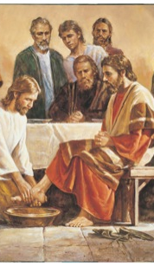
4. How did the Messiah keep Passover?
MELCHIZEDEK
Blood represented by the cup of wine
Luke 22: 20
Body (flesh) represented by bread
Luke 22: 19
Kingdom bestowed on disciples-spiritual one
(Luke 22: 29)
Foot washing
John 13: 1-17
Notes:
So how did Messiah Yahusha keep Passover with the disciples the night before he died?
He firstly in Luke 22 introduces the new covenant meal. “¹⁷ After taking the cup, he gave thanks and said, “Take this and divide it among you. ¹⁸ For I tell you I will not drink again from the fruit of the vine until the kingdom of God comes.”
¹⁹ And he took bread, gave thanks and broke it, and gave it to them, saying, “This is my body given for you; do this in remembrance of me.”
²⁰ In the same way, after the supper he took the cup, saying, “This cup is the new covenant in my blood, which is poured out for you.”
This is the covenant meal whereby the Messiah institutes the new covenant with humankind under the Melchizedek priesthood. He is doing the bread and wine as his bread and body in anticipation for the future event of the following day where it will be fulfilled in himself, and the event 3 days after that of His resurrection, which is the final activation of the Melchizedek priesthood which is based on the power of an indestructible life.
This is why we share these symbols together on Passover, to remember this covenant that we have made with the Father and Yahusha.
Then Messiah does foot washing with his disciples. John 13 says: “¹² When he had finished washing their feet, he put on his clothes and returned to his place. “Do you understand what I have done for you?” he asked them. ¹³ “You call me ‘Teacher’ and ‘Lord,’and rightly so, for that is what I am. ¹⁴ Now that I, your Lord and Teacher, have washed your feet, you also should wash one another’s feet. ¹⁵ I have set you an example that you should do as I have done for you. ¹⁶ Very truly I tell you, no servant is greater than his master, nor is a messenger greater than the one who sent him. ¹⁷ Now that you know these things, you will be blessed if you do them.”
This sign of love, humility and servant-heartedness, is an amazing part of the Passover kept according to Messiah. It is a time where one can bless each other outloud in the family unit or fellowship community, pray for each other and also can provide opportunity to ask for forgiveness from the person, for anything done over the past year, of simply just a time to be quiet together. We find this always a special time.

Slide 7
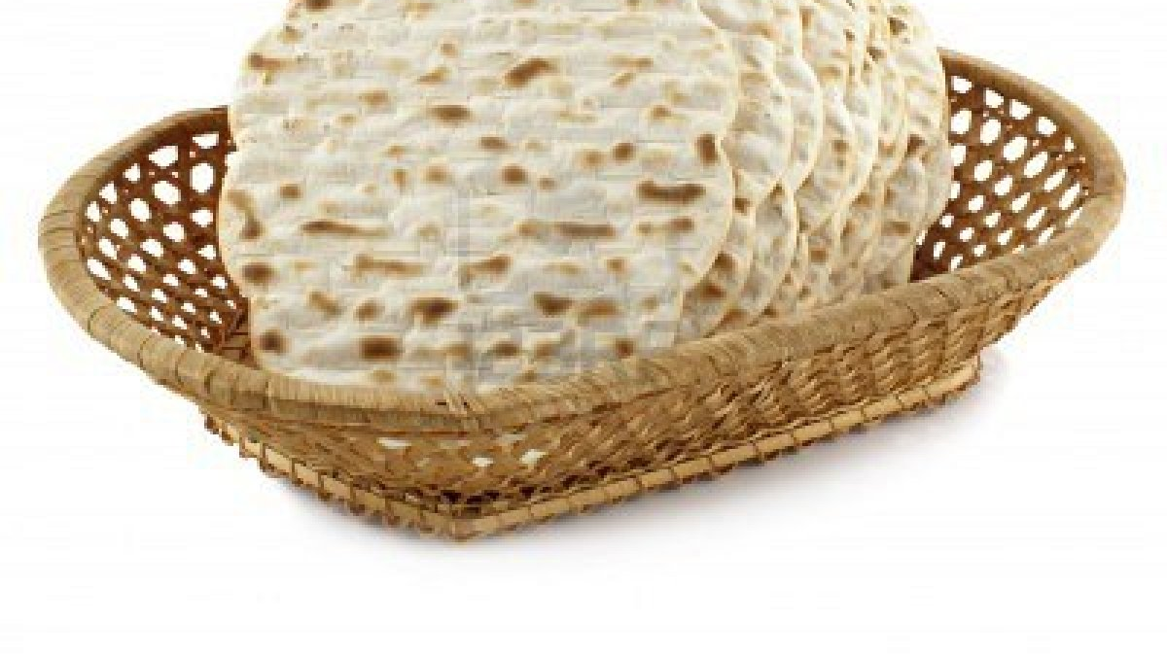
Why should we keep Passover?
Lk. & Jn. – Yahusha says so.
Read 1 Cor 5: 7 – 8 – Paul says so.
1 Cor 10: 16; & 11: 20-34
The issue of yeast:
  False doctrine (Matt 16:6-12)
  Hypocrisy (Luke 12:1)
  Sin (1 Cor 5:8)
Notes:
Luke 22:16 “For I tell you, I will not eat it again until it finds fulfillment in the kingdom of God.” Implying we will eat it again with him for the ultimate fulfillment in eternity.
1 Cor 5:7-8 “⁶ Your boasting is not good. Don’t you know that a little yeast leavens the whole batch of dough?⁷ Get rid of the old yeast, so that you may be a new unleavened batch—as you really are. For Christ, our Passover lamb, has been sacrificed. ⁸ Therefore let us keep the Festival, not with the old bread leavened with malice and wickedness, but with the unleavened bread of sincerity and truth.”
Yeast is translated by scripture for us as representing:
False doctrine Mat 16:6-12
Malice and wickedness 1Cor 5:8
Hypocrisy Luke 12:1
So in the week of unleavened bread, which is the week after Passover, we can focus not on the physical lack of eating yeast, but rather focus on allowing the Holy Spirit to reveal to us secret sins, unconscious sins, areas where we are hypocritical, areas that we have false doctrine. It’s a time to really press into YHWH to pray about these things, and trust Him to reveal them to us, so we can move forward into the year in SINCERITY and TRUTH.

Slide 8
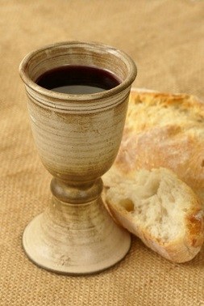
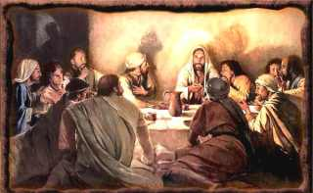
End
Lets do:
  Bread and wine
  Foot washing
  Feast & Celebrate!

Slide 9
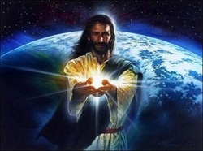
The great commission
Go out into all the world…

